Slide 1
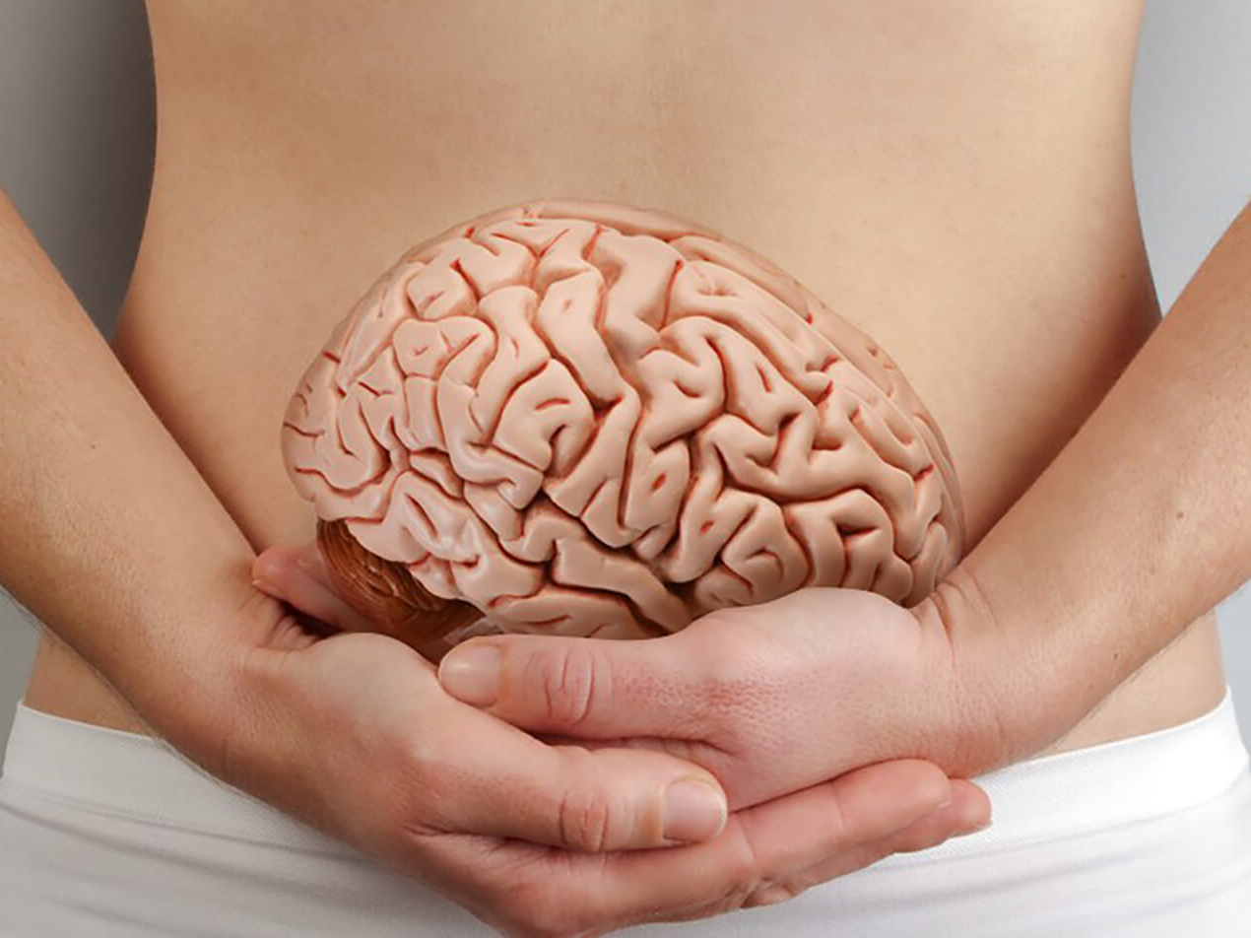
Nourish the Gut Nourish the Brain
Dr. Nicole DiNezza, DC, NTP

Slide 2
About Me
Training:
Doctor of Chiropractic (DC)
Nutritional Therapy Practitioner (NTP)
Additional training in functional medicine and herbal medicine
Owner, physician:

Slide 4
Outline
Inflammation and Alzheimer’s Disease
Overview of normal gut function
Digestion
Microbes
When things go wrong
Microbe imbalance (Dysbiosis)
Irritable Bowel Syndrome (IBS)
Leaky Gut Syndrome
The role of diet and gut health in brain health

Slide 5
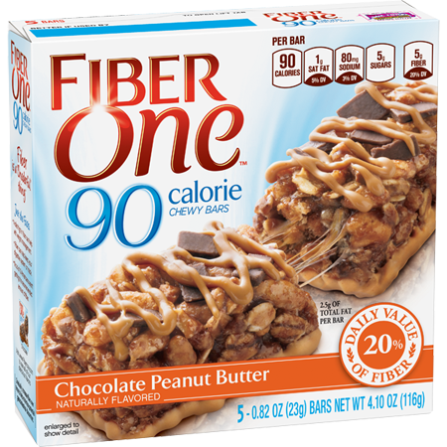
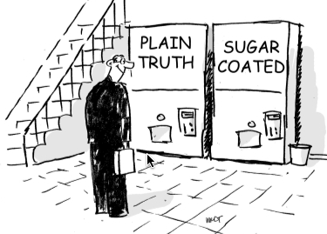
But First…
I’m not going to sugar coat things
There is no shortcut for eating real food

Slide 6
Inflammation: The Fire Within

Slide 7
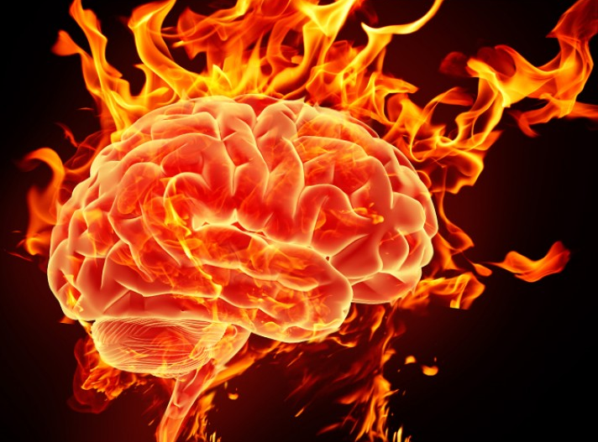
Inflammation Plays a Key Role in AD
“Brain on fire”

Slide 8
Thapa, A., & Carroll, N. J. (2017). Dietary Modulation of Oxidative Stress in Alzheimer’s Disease. International Journal of Molecular Sciences, 18(7), 1583. http://doi.org/10.3390/ijms18071583

Slide 9
Thapa, A., & Carroll, N. J. (2017). Dietary Modulation of Oxidative Stress in Alzheimer’s Disease. International Journal of Molecular Sciences, 18(7), 1583. http://doi.org/10.3390/ijms18071583
Compared to other cells Neurons
Create more inflammation
Are more susceptible to inflammation
Have lower anti-oxidant levels

Slide 10
Wu, S.-C., Cao, Z.-S., Chang, K.-M., & Juang, J.-L. (2017). Intestinal microbial dysbiosis aggravates the progression of Alzheimer’s disease in Drosophila. Nature Communications, 8, 24. http://doi.org/10.1038/s41467-017-00040-6
“... inflammation in the brain is not always a response to local primary insults. Gut microbiota dysbiosis, which is recently emerging as a risk factor for psychiatric disorders, can also initiate a brain inflammatory response.”

Slide 11
Wu, S.-C., Cao, Z.-S., Chang, K.-M., & Juang, J.-L. (2017). Intestinal microbial dysbiosis aggravates the progression of Alzheimer’s disease in Drosophila. Nature Communications, 8, 24. http://doi.org/10.1038/s41467-017-00040-6
“The recruitment of peripheral (blood) immune cells to the brain may be induced by the presence of inflammation/injury originating from the brain, such as ischemic stroke, traumatic brain injury (TBI) and neurodegenerative diseases. Accordingly, in a broad sense, the enteric infection-induced hemocyte recruitment to the AD brain is functionally equivalent to the stroke/TBI-induced focal recruitment of peripheral immune cells in eliciting brain inflammatory response.”
In Other Words
Inflammation = Inflammation
No matter where it originates from

Slide 12
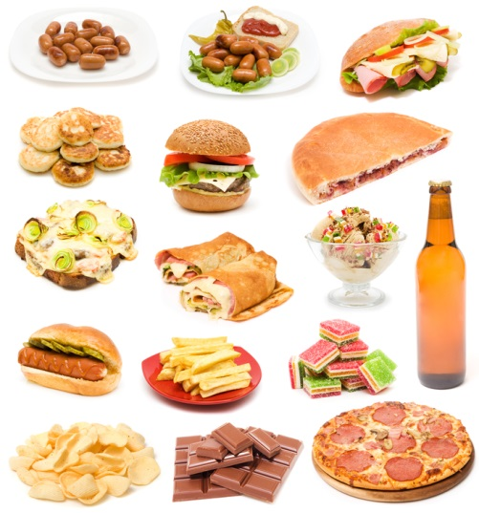
Sources of Inflammation
Poor diet
Infection/microbes
Injury
Exposure to toxins
Normal Metabolism

Slide 13
Sources of Inflammation
Poor diet
Infection/microbes
Injury
Exposure to toxins
Normal Metabolism

Slide 14
“Can I Just Take a Pill?”
“There is increasing interest in developing anti-oxidative supplements to prevent AD. There are contradictory and inconsistent reports on the possible benefits of anti-oxidative supplements; however, fruits and vegetables enriched with multiple anti-oxidants (e.g. flavonoids and polyphenols) and minerals may be highly effective in attenuating the harmful effects of oxidative stress.”
Thapa, A., & Carroll, N. J. (2017)

Slide 15
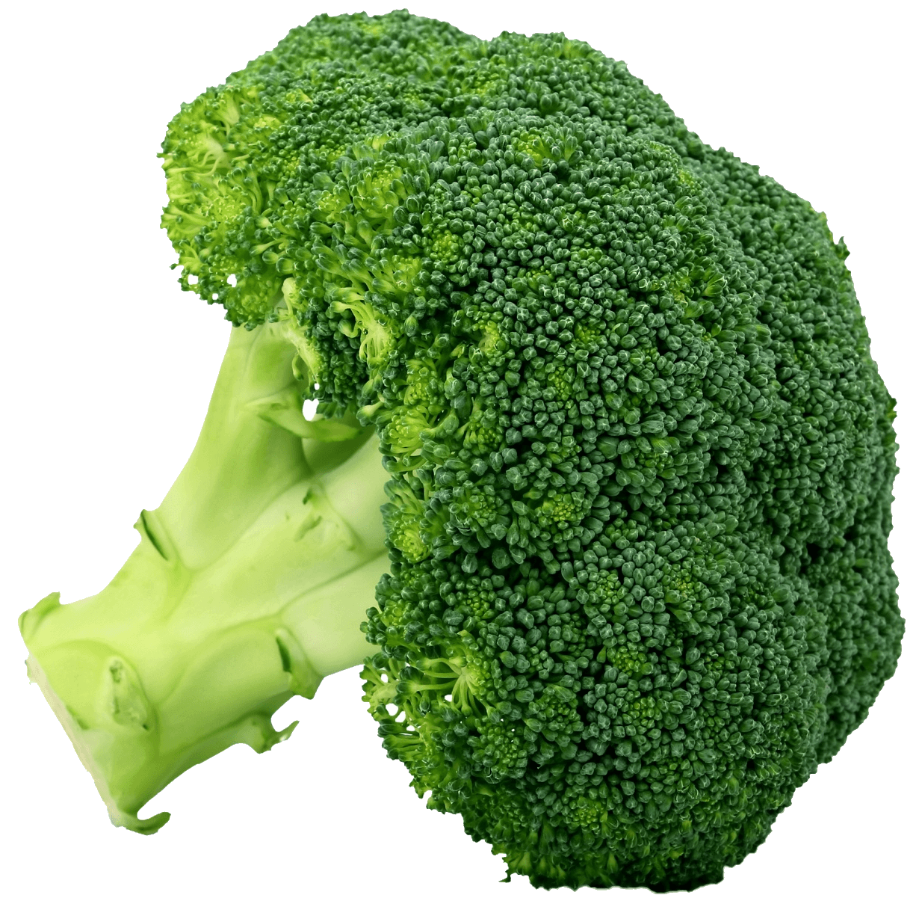
Thapa, A., & Carroll, N. J. (2017). Dietary Modulation of Oxidative Stress in Alzheimer’s Disease. International Journal of Molecular Sciences, 18(7), 1583. http://doi.org/10.3390/ijms18071583

Slide 16
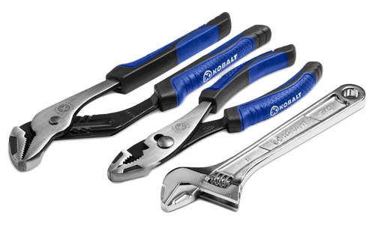
Your Body is Intelligent
Inflammation isn’t your body's fault, it’s just trying to cope with something
An inflamed body just needs
The right tools
Help

Slide 17
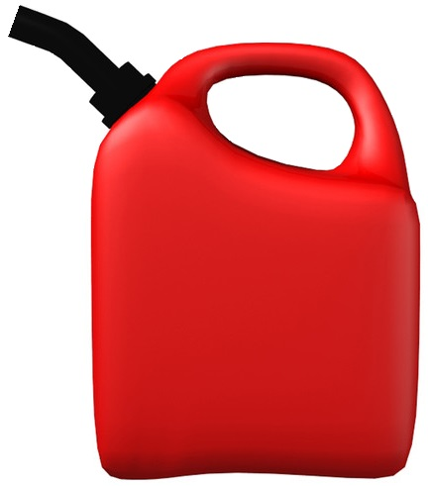
How Inflammation Works

Slide 18
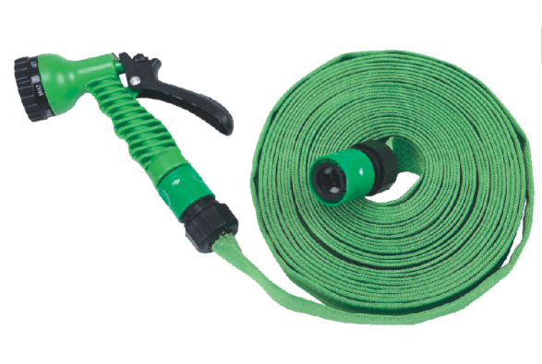
Will This Be Effective?

Slide 19
Will This Be Effective?

Slide 20
Now We’re Talkin’

Slide 21
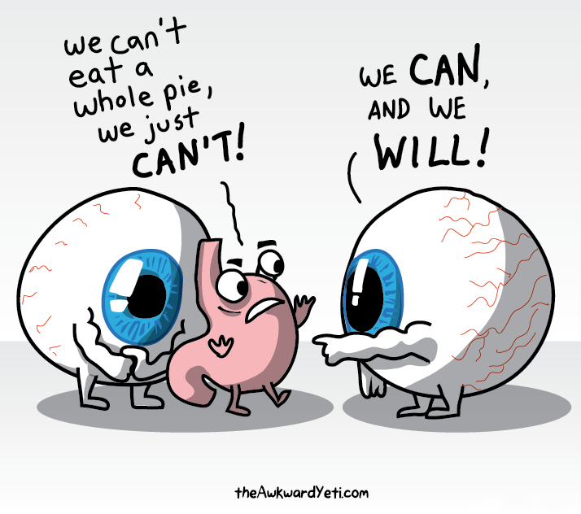
Getting to Know Your Gut
Anatomy and Function
Inside = Outside
Immune System
Microbes
Gut-Brain Relationship

Slide 22
“But My Gut Feels Fine”
1.3% of
Completely asymptomatic people

Slide 23
Damaged
Intestines
Normal
Small Intestine
+ Antibody test

Slide 24
Autoimmunity 101
Antibody
Production
Signs/
Symptoms
Diagnosis
(+ Treatment)
1
2
3

Slide 25
3
Damaged
Intestines
2
Normal
Small Intestine
1
+ Antibody test

Slide 26
Celiac Disease is Underdiagnosed

Slide 27
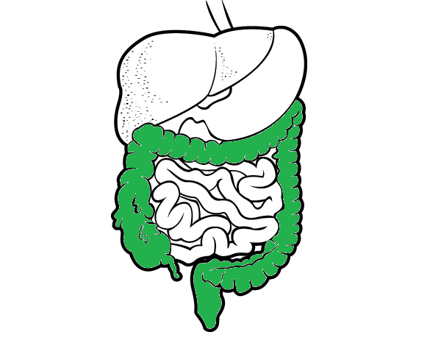
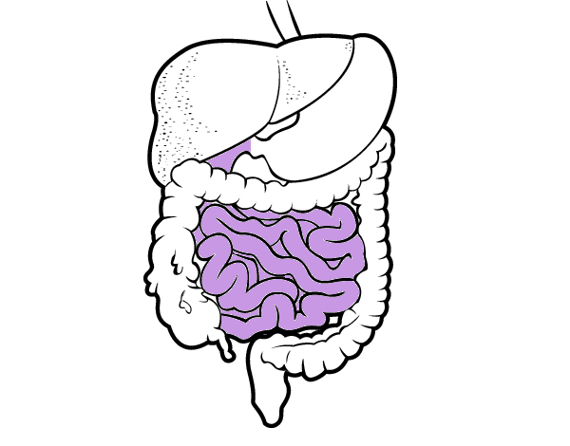
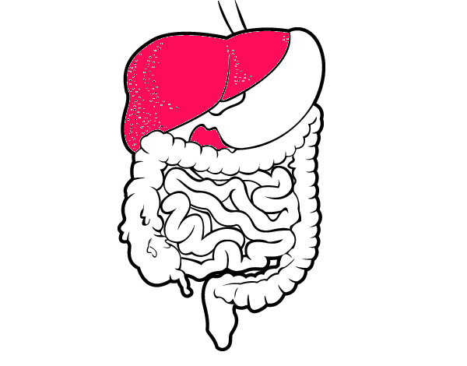
Anatomy and Function of the Gut

Slide 28
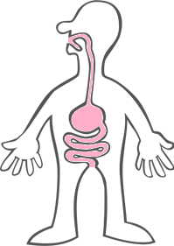
Inside of You = Outside

Slide 29
70% of Your Immune System

Slide 30
Gut Brain Axis
Wang, H.-X., & Wang, Y.-P. (2016). Gut Microbiota-brain Axis. Chinese Medical Journal, 129(19), 2373–2380. http://doi.org/10.4103/0366-6999.190667

Slide 31
Your Microbes Outnumber You

Slide 32
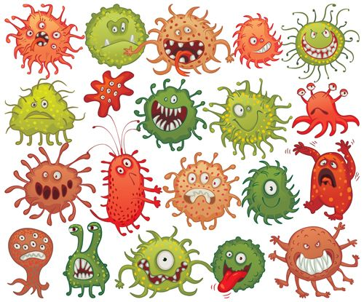
Microbes: Friend or Foe?
Make some of our vitamins
Vitamin K2
Vitamin B7 (Biotin)
Make anti-inflammatory molecules
Short Chain Fatty Acids (SCFA)
“Teach” our immune cells
Crowd out “bad” bugs

Slide 33
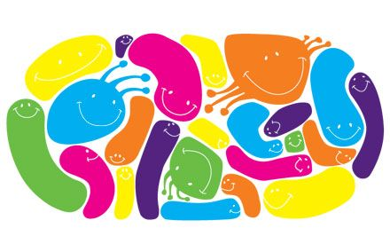
Huang, R., Wang, K., & Hu, J. (2016). Effect of Probiotics on Depression: A Systematic Review and Meta-Analysis of Randomized Controlled Trials. Nutrients, 8(8), 483. http://doi.org/10.3390/nu8080483
“We found that probiotics were associated with a significant reduction in depression”
“Probiotics had an effect on the population aged under 60 ,while it had no effect on people aged over 65”

Slide 34
Normal = Balance
More
Less
“Good”
“Bad”

Slide 35
Dysbiosis = Imbalance
More
Less
“Good”
“Bad”

Slide 36
Dysbiosis = Imbalance
More
Less
“Good”
“Bad”

Slide 37
Dysbiosis = Imbalance
More
Less
“Good”
“Bad”

Slide 38
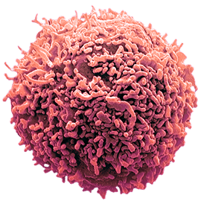
Dysbiosis: What Happens
Gut becomes inflamed and permeable
AKA “leaky gut syndrome”
Poor absorption of nutrients
Risk of food sensitivities
Risk of autoimmunity
Bacterial toxins get through
Ex. LPS
T Cell

Slide 39
Lukiw, W. J. (2016). The microbiome, microbial-generated proinflammatory neurotoxins, and Alzheimer’s disease. Journal of Sport and Health Science, 5(4), 393–396. http://doi.org/10.1016/j.jshs.2016.08.008
Inflammation

Slide 41
Lukiw, W. J. (2016). The microbiome, microbial-generated proinflammatory neurotoxins, and Alzheimer’s disease. Journal of Sport and Health Science, 5(4), 393–396. http://doi.org/10.1016/j.jshs.2016.08.008
“This contribution of noxious, proinflammatory molecules from the GI tract microbiome may be increasingly important during the course of aging, when both the GI tract and blood–brain barriers become significantly more permeable. Interestingly, high intake of dietary fiber is a strong inhibitor of B. fragilis abundance and proliferation in the human GI tract and as such is a potent inhibitor of the neurotoxic B. fragilis-derived amyloids, LPSs, and enterotoxins. Hence dietary fiber-mediated suppression of B. fragilis abundance may be beneficial for both human GI tract and CNS health.”

Slide 42
Lukiw, W. J. (2016). The microbiome, microbial-generated proinflammatory neurotoxins, and Alzheimer’s disease. Journal of Sport and Health Science, 5(4), 393–396. http://doi.org/10.1016/j.jshs.2016.08.008

Slide 43
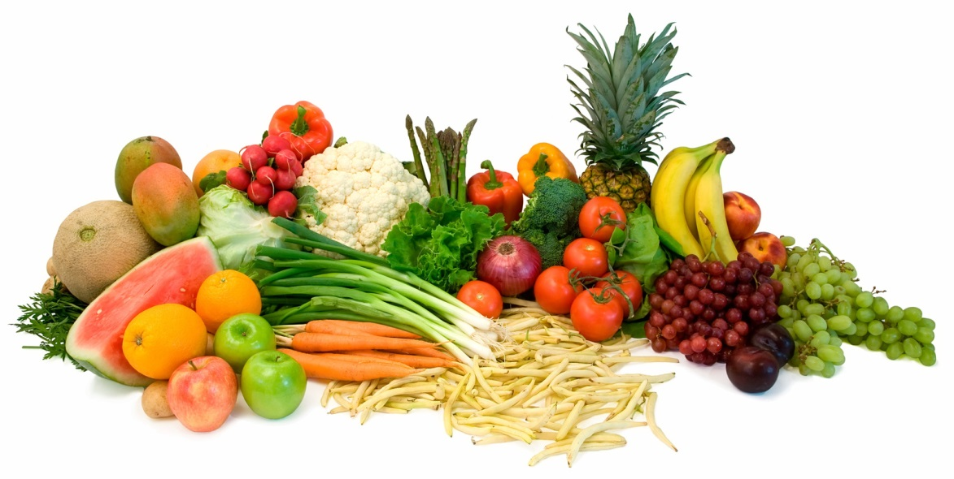
Fiber is Found In:
Vegetables
Fruits
Whole Grains
Legumes

Slide 44
Fiber is Found In:
Vegetables
Fruits
Whole Grains
Legumes

Slide 45
Bonfili, L., Cecarini, V., Berardi, S., Scarpona, S., Suchodolski, J. S., Nasuti, C., … Eleuteri, A. M. (2017). Microbiota modulation counteracts Alzheimer’s disease progression influencing neuronal proteolysis and gut hormones plasma levels. Scientific Reports, 7, 2426. http://doi.org/10.1038/s41598-017-02587-2
Note: Mouse study

Slide 46
Bonfili, L., Cecarini, V., Berardi, S., Scarpona, S., Suchodolski, J. S., Nasuti, C., … Eleuteri, A. M. (2017). Microbiota modulation counteracts Alzheimer’s disease progression influencing neuronal proteolysis and gut hormones plasma levels. Scientific Reports, 7, 2426. http://doi.org/10.1038/s41598-017-02587-2
Probiotics:
Positively altered the gut microbiota
Positively influenced inflammatory molecules
Positively influenced gut hormones
Reduced Beta Amyloid load
Improved cognitive function

Slide 47
Chen, C.-H., Lin, C.-L., & Kao, C.-H. (2016). Irritable Bowel Syndrome Is Associated with an Increased Risk of Dementia: A Nationwide Population-Based Study. PLoS ONE, 11(1), e0144589. http://doi.org/10.1371/journal.pone.0144589
42.5% Increase

Slide 49
What is Irritable Bowel Syndrome?

Slide 50
Irritable Bowel Syndrome
Abdominal pain
Abdominal b l o a t i n g
Indigestion
Nausea
Excessive gas
Diarrhea
Constipation
Alternating Diarrhea and Constipation

Slide 51
What Causes IBS?
Many things:
Inflammation
Motility problems
Autoimmunity
Food Sensitivities
Leaky Gut
Wonky gut bugs
SIBO
← Available on my website

Slide 52
Small Intestinal Bacterial Overgrowth
“Bugs in the wrong place”
The most common cause of IBS (65-85%)
Underdiagnosed
Hallmark Symptoms:
Bloating after eating
Improvement on low FODMAP diet or SCD

Slide 53
“Leaky Gut” Syndrome
Photo from:
https://www.thepaleomom.com/what-is-leaky-gut-and-how-can-it-cause/

Slide 54
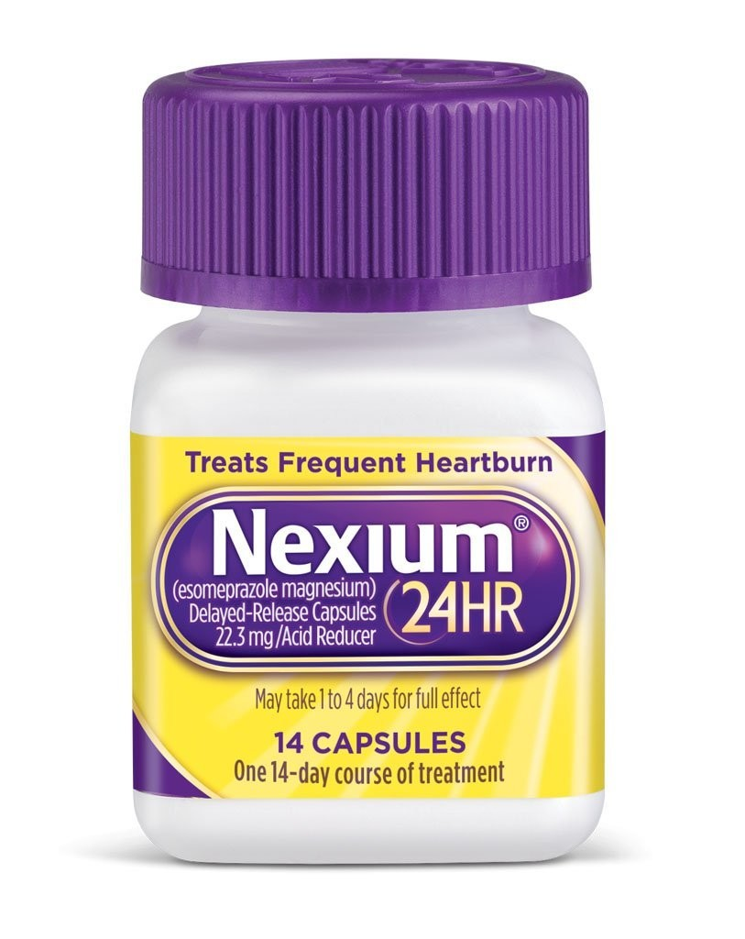
Proton Pump Inhibitors (PPIs)
Medication for acid reflux
Prilosec
Omeprazole
Prevacid
Protonix
Nexium
Zegerid
Dexilent

Slide 55
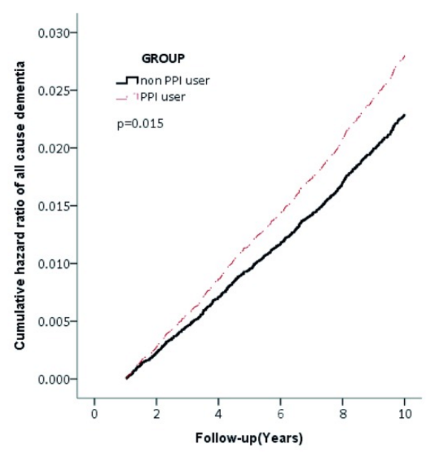
Tai, S.-Y., Chien, C.-Y., Wu, D.-C., Lin, K.-D., Ho, B.-L., Chang, Y.-H., & Chang, Y.-P. (2017). Risk of dementia from proton pump inhibitor use in Asian population: A nationwide cohort study in Taiwan. PLoS ONE, 12(2), e0171006. http://doi.org/10.1371/journal.pone.0171006
15,726 people
PPI users had a 21% increased risk of dementia
Cumulative PPI use was significantly associated with dementia
Male PPI users were more at risk than women

Slide 56
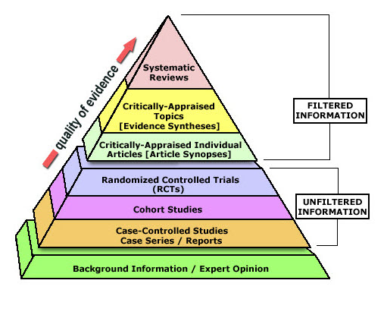
Wijarnpreecha, K., Thongprayoon, C., Panjawatanan, P., & Ungprasert, P. (2016). Proton pump inhibitors and risk of dementia. Annals of Translational Medicine, 4(12), 240. http://doi.org/10.21037/atm.2016.06.14
Meta-analysis
106,942 people
PPI users had a 40% increased risk of dementia

Slide 57
Why the Increased Risk?
Interference with absorption of nutrients
B12
Magnesium
Increased risk of Small Intestinal Bacterial Overgrowth (SIBO)
Atrophy of the gastric mucosa
Change in microbiota composition

Slide 58
Minalyan A, Gabrielyan L, Scott D, Jacobs J, Pizegna JR (2017). The Gastric and Intestinal Microbiome: Role of Proton Pump Inhibitors. Curr Gastroenterol Rep, 19(8), doi: 10.1007/s11894-017-0577-6
“The overuse of PPIs leads to significant shift of the gastrointestinal microbiome towards a less healthy state. With the advent of PPIs, many studies have demonstrated the significant changes in the microbial composition of both gastric and intestinal microbiota. Although they are considered relatively safe over-the-counter medications, PPIs in many cases are over- and even inappropriately used. Future studies assessing the safety of PPIs and their role in the development of microbiome changes should be encouraged.”

Slide 59
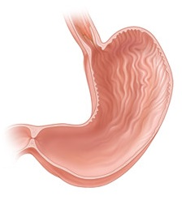
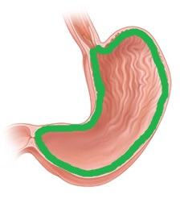
Alternatives to PPIs
Identify the reason for the reflux (and treat it)
Infection
Autoimmunity
Poor diet
Lack of mucous lining
Herbs (Ex. DGL Licorice)
Dietary changes

Slide 60
Practical Advice
“What do I do now?”

Slide 61
#1: Eat Healthy
“Eat food – not too much – mostly plants”
-Michael Pollan
Eat:
As many vegetables as you can
A moderate amount (2-3/day) of fruit
As little processed food as possible
Everything else in moderation (meat, grains, dairy)
If you tolerate it

Slide 62
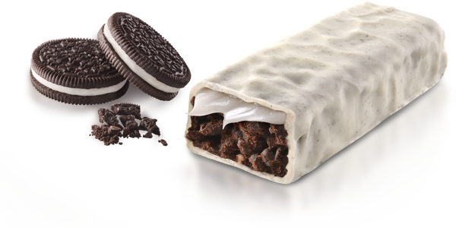
#2: There is No Shortcut

Slide 63
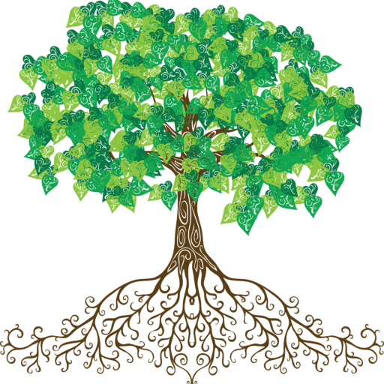
#3: Seek Treatment for Health Conditions
Get to the root of:
Irritable Bowel Syndrome
Reflux, GERD
Constipation
Hypothyroidism
Autoimmune diseases
Inflammatory diseases

Slide 64
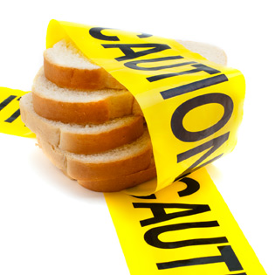
#4: Get Tested for Celiac Disease
Especially if:
You have an autoimmune disease of any kind
You are related to someone with Celiac Disease
Antibody tests:
Anti-tissue transglutaminase (tTG) antibodies
Endomysial antibodies
Deamidated Gliadin Peptide (DGP) antibodies

Slide 65
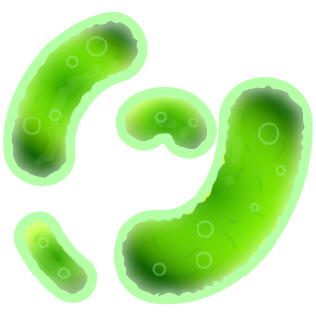
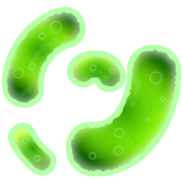
#5: Consider Probiotics
It may take a few tries to find one you like
Include fermented foods if you tolerate them
Not recommended for people with migraines, hives, or mast cell disorders
Intolerance to probiotics is indicative of SIBO

Slide 66
#6: Be a Good Bug Roommate
Exercise
Eat a wide variety of (healthy) foods
Limit sugar and alcohol
Get plenty of sleep
Avoid antibiotics whenever possible

Slide 67
Dr. Nicole DiNezza, DC, NTP
Infinity Holistic Healthcare, Chapel Hill
InfinityHolisticHealth.com

